Slide 2
Selection : mapping business needs to technical capabilities
External Vendors
Salesforce CRM
ERP Implementation(SAP S/4 HANA for Supply Chain Order-To-Cash which tracks from order to returns workflow)
Data Science (ML/AI): On-Premise Data-Warehouse to SAAS On-Cloud DataBricks Data LakeHouse
Electronic Medical Records (EMR) EPIC Implementation
Governance: Alation
Business Intelligence Systems: Power BI, Tableau
AirTable
MicroSoft Cloud Apps (SharePoint, Power Automate, Power Apps, Forms, etc.)
In-House IT Developed & Managed
Supply Chain Network Analysis & Modeling
IT PMO Application

Slide 3
Intro
Computer Eng
Data Science
HealthCare / Government

Slide 4
IT/Business Bridge
Full Stack Dev
Data: Data Science (ML/AI) Data Engineers, Business Intelligence, DBA, Data & ML Ops
Networking
Cyber Security
Compliance
Finance
Cross-Functional: Supply Chain, Sales & Marketing, Business Units
Non-Tech Community (Social Workers, Nurses, Doctors, HealthCare Admins/Mgrs, etc.)ma
Executive Leadership

Slide 5
Selection : mapping business needs to technical capabilities
Gather Requirements: Document functional needs and non-functional needs like security and scalability.
Industry Compliance Regulations: Ex HIPAA, PII, GDPR<,CFR Part 2 etc.
Define Criteria: Create a weighted scoring matrix for vendor features, cost, and support.
Market Research: Evaluate vendor landscapes using industry reports and request for proposals (RFPs).
Proof of Concept: Test the top two solutions in a sandbox environment using real data.
Financial Analysis: Compute the Total Cost of Ownership (TCO) for a five-year period
Business Requirements Document (BRD): Defines high-level business goals and user needs.
System Requirements Specification (SRS): Details functional and non-functional technical constraints.
Request for Proposal (RFP): Invites vendors to bid based on project needs.
Vendor Scoring Matrix: Scores vendor features using a weighted evaluation model.
Total Cost of Ownership (TCO) Model: Forecasts five-year licensing, implementation, and operating costs.
Proof of Concept (PoC) Evaluation Report: Documents outcomes, limitations, and findings from sandbox testing

Slide 6
Solution Architecture Review: selected application safely and efficiently fits into your existing ecosystem.
System Architecture Diagram: Visualizes infrastructure, network zones, and component interactions.
Data Flow Diagram (DFD): Tracks data movement, boundaries, and storage points across systems.
Integration Specification Document: Defines APIs, data payloads, webhooks, and middleware configurations.
Security & Compliance Assessment: Documents encryption standards, identity management (IdP), and regulatory alignments.
Disaster Recovery (DR) & BCP Plan: Outlines failover steps, RPO/RTO metrics, and backup schedules.
System Integration: Map data flows between the new application and existing core systems.
Security Compliance: Validate identity management, data encryption, and regulatory compliance (e.g., GDPR, HIPAA).
Scalability Check: Review infrastructure limits to handle peak user loads and data growth.
Disaster Recovery: Verify Recovery Time Objectives (RTO) and Recovery Point Objectives (RPO).
Tech Stack Alignment: Ensure the solution uses approved databases, languages, and cloud providers.

Slide 7
Implementation: bridge between developers, vendors, and business stakeholders during rollout.
Phased Roadmap: Divide the deployment into manageable sprints or milestone-based phases.
Data Migration: Extract, transform, and load (ETL) legacy data into the new system schema.
Environment Strategy: Configure separate environments for development, testing, staging, and production.
Rigorous Testing: Execute user acceptance testing (UAT), performance testing, and regression testing.
Change Management: Conduct user training sessions and document clear system workflows
Implementation Roadmap & Project Plan: Details phase timelines, work breakdown structures, and resource paths.
Data Migration Plan (ETL): Maps source-to-target fields, transformation rules, and validation checks.
Test Plan & Test Scripts: Outlines QA parameters, UAT scenarios, and expected outcomes.
Deployment Checklist (Runbook): Provides step-by-step technical instructions for the production launch.
User Training & Workflow Documentation: Offers step-by-step guides for system administrators and end users

Slide 8
Post Deployment Support: Continuous monitoring and optimization ensure the application delivers long-term value.
Hypercare Period: Provide dedicated, immediate technical support for the first 30 days post-launch.
SLA Monitoring: Track vendor uptime, system latency, and support ticket resolution times.
Feedback Loops: Collect user pain points to prioritize future bug fixes and feature updates.
Performance Tuning: Optimize database queries and infrastructure allocation based on real usage patterns.
Routine Maintenance: Schedule regular security patches, certificate renewals, and version upgrades.
Standard Operating Procedures (SOPs): Details routine system management, provisioning, and troubleshooting steps.
Service Level Agreement (SLA) Matrix: Defines support tiers, response times, and escalation paths.
Hypercare Log & Incident Report: Tracks bugs, resolutions, and system stability during initial launch.
Patch & Release Management Policy: Schedules cadence for version updates, hotfixes, and security patches.

Slide 9
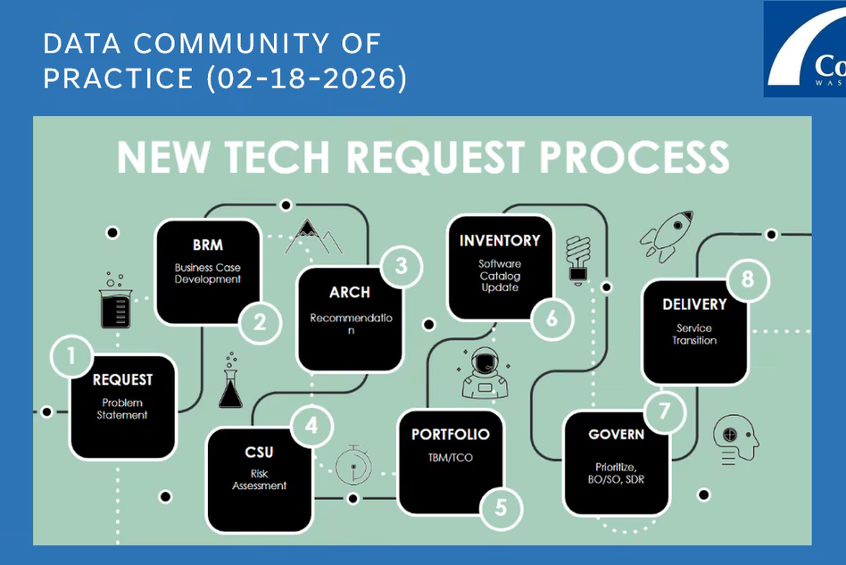
IT PMO

Slide 10
IT PMO

Slide 11
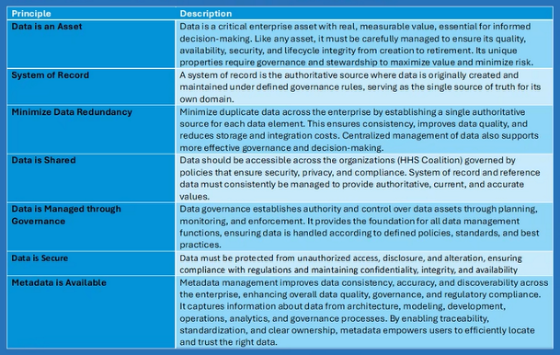
Data as a shared resouce

Slide 12
User Adoption
User/Community Development
Business Champions
Training Videos & Presentations
Self-Help Resources (JavaScript based animated videos)
How-To-Instruction manuals
On-site: Office Hours
Outside: Coffee Chat / Fireside Pizza / Friday Happy Hours etc.

Slide 13
Communication

Slide 14
Program Status

Slide 15
Collaboration: Handling Conflicts

Slide 16
Improvement
Intelligent Work Assignment
Ability to get a place in line
Online Status Tracker
Site with self-help resources, training videos, how-to-instruction manual

